Slide 1
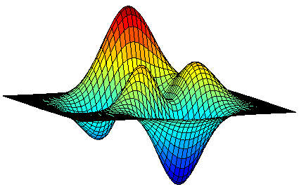
Unconstrained Submodular Maximization
Moran Feldman
The Open University of Israel
Based On
Maximizing Non-monotone Submodular Functions.
Uriel Feige, Vahab S. Mirrokni and Jan Vondrák, SIAM J. Comput 2011.
A Tight Linear Time (1/2)-Approximation for Unconstrained Submodular Maximization.
Niv Buchbinder, Moran Feldman, Joseph (Seffi) Naor and Roy Schwartz, SIAM J. Comput 2015.
Deterministic Algorithms for Submodular Maximization Problems.
Niv Buchbinder and Moran Feldman, SODA 2016 (to appear).

Slide 2
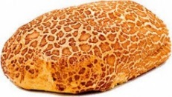

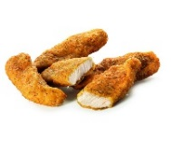

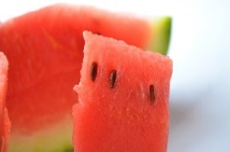
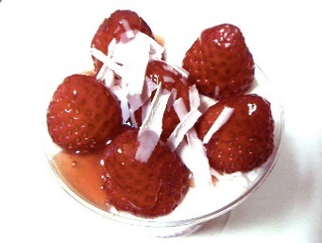
Motivation: Adding Dessert
Meal 1 | Meal 2
Alternative Definition
f(A) + f(B) ≥ f(A ∪ B) + f(A ∩ B)
∀ A, B ⊆ N.
Ground set N of elements (dishes).
Valuation function f : 2^{N}  ℝ (a value for each meal).
Submodularity: f(A + u) – f(A) ≥ f(B + u) – f(B)
∀ A ⊆ B ⊆ N, u ∉ B.

Slide 3


Another Example
7
11
0
6
8
0
5
10
5
N
4
-8

Slide 4


Subject of this Talk
Unconstrained Submodular Maximization
A basic submodular optimization problem.
Given a non-negative submodular function f : 2^{N}  ℝ, find a set A ⊆ N maximizing f(A).
Study the approximability of this problem.
Algorithms should be polynomial in |N|.
Representation of f might be very large.
Assume access via a value oracle:
Given a subset A ⊆ N, returns f(A).

Slide 5
Motivation: Generalizes Max-DiCut
Max-DiCut
Instance: a directed graph G = (V, E) with capacities c_{e} ≥ 0 on the arcs.
Objective: find a set S ⊆ V of nodes maximizing
(the total capacity of the arcs crossing the cut).
Capacity: 2
Marginal gain: 0
Marginal gain: -1

Slide 6

History of the Problem
Randomized Approximation Algorithms
0.4 – non-oblivious local search [Feige et al. 07]
0.41 – simulated annealing [Oveis Gharan and Vondrak 11]
0.42 – structural continuous greedy [Feldman et al. 11]
0.5 – double greedy [Buchbinder et al. 12]
Deterministic Approximation Algorithms
0.33 – local search [Feige et al. 07]
0.4 – recurisve local search [Dobzinski and Mor 15]
0.5 – derandomized double greedy [Buchbinder and Feldman 16]
Approximation Hardness
0.5 – information theoretic based [Feige et al. 07]

Slide 7
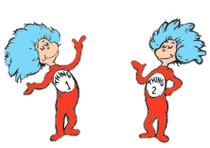
Generic Double Greedy Algorithm
Initially: X = ∅, Y = N = {u₁, u₂, …, u_{n}}.
For i = 1 to n do:
Either add u_{i} to X, or remove it from Y.
Return X (= Y).
Running example:
Y =
u₁
u₂
u₃
u₄
u₅
u₆
…
u_{n}
X =
u₁
u₃
u₄

Slide 8

Simple Decision Rule
Intuitively, we want to maximize f(X) + f(Y).
In each iteration we have two options: add u_{i} to X, or remove it from Y.
We choose the one increasing the objective by more.
a_{i} = f(X + u_{i}) – f(X) is the change from adding u_{i} to X.
b_{i} = f(Y - u_{i}) – f(Y) is the change from removing u_{i} from Y.
If a_{i} ≥ b_{i} , add u_{i} to X.
Otherwise, remove u_{i} from Y.

Slide 9
Analysis Roadmap
HYB - A hybrid solution
Starts as OPT, and ends as X (= Y).
If X and Y agree on u_{i}, HYB also agrees with them.
Otherwise, HYB agrees with OPT.
Assume in every iteration:
Gain ≥ c ∙ Damage for some c > 0.
Assume in every iteration:
Gain ≥ c ∙ Damage for some c > 0.
f(OPT)
Ratio
Output
The output of the algorithm.
Damage
f(HYB)
1
[f(X) + f(Y)]/2
c
Gain
iterations

Slide 10

Simple Decision Rule - Gain
If a_{i} ≥ b_{i}, we add u_{i} to X, and f(X) increases by a_{i}.
If a_{i} < b_{i}, we remove u_{i} from Y, and f(Y) increases by b_{i}.
f(X) + f(Y) increases by max{a_{i}, b_{i}}.
Lemma
The gain is always non-negative.

Slide 11

Gain Non-negativity - Proof
By submodularity: a₅ ≥ (-b₅)
Y
In
Y
a₅ + b₅ ≥ 0
b₅
max{a₅, b₅} ≥ 0
(-b₅)
a₅
Out
X
u₁
u₂
u₃
u₄
u₅
u₆
u₇
…
u_{n}

Slide 12

Simple Decision Rule - Damage
When the algorithm makes the “right” decision
The algorithm adds to X an element u_{i} ∈ OPT, or
The algorithm removes from Y an element u_{i} ∉ OPT.
HYB does not change.
No damage.
Summary
Gain ≥ 0
Damage = 0
Gain ≥ c ∙ Damage for every c > 0.

Slide 13
Wrong Decision - Damage Control
(-Damage)
By submodularity: a₅ ≥ Damage
In
Y
Lemma
When making a wrong decision, the damage is at most the a_{i} or b_{i} corresponding to the other decision.
b₅
HYB
HYB
a₅
Out
X
Damage
u₁
u₂
u₃
u₄
u₅
u₆
u₇
…
u_{n}

Slide 14
Doing the Math
When the algorithm makes the “wrong” decision
The damage is upper bounded by either a_{i} or b_{i}.
The gain is .
(i.e., c = ½).
Approximation Ratio

Slide 15

Intuition
If a_{i} is much larger than b_{i} (or the other way around).
If a_{i} and b_{i} are close.
Even if our decision rule makes a wrong decision:
The gain a_{i}/2 is much larger than the damage b_{i}.
Allows a larger c.
Both decisions result in a similar gain.
Making the wrong decision is problematic.
We should give each decision some probability.

Slide 16
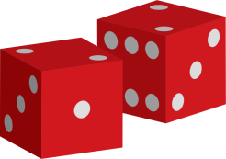
Randomized Decision Rule
For simplicity, assume this case.
If b_{i} ≤ 0, add u_{i} to X.
If a_{i} ≤ 0, remove u_{i} from Y.
Otherwise:
  With probability add u_{i} to X.
  Otherwise (with probability ) remove u_{i} from Y.
Gain Analysis
𝔼[Gain] = 𝔼

Slide 17
Randomized Decision Rule - Damage
If u_{i} ∈ OPT: 𝔼[Damage] ≤
If u_{i} ∉ OPT: 𝔼[Damage] ≤
Damage from making the “right” decision.
Damage from making the “wrong” decision.
Approximation Ratio
𝔼[Damage] ≤
Approximation ratio:
= 𝔼[Gain]
c = 1
✓

Slide 18
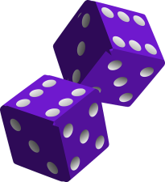
Derandomization – First Attempt
Idea:
The state of the random algorithm is a pair (X, Y).
Explicitly store the distribution over the current states of the algorithm.
(∅, N, 1)
The number of states can double after every iteration.
Can require an exponential time.
(X, Y, p)
(X, Y, 1-p)
(X, Y, q₁)
(X, Y, q₄)
(X, Y, q₂)
(X, Y, q₃)

Slide 19

Notation
We want to select these smartly.
Think of them as variables.
S = (X, Y)
p(S) is the probability of S.
z(S)
w(S)
The probability of adding u_{i}.
The probability of removing u_{i}.
(X+u_{i}, Y)
(X, Y-u_{i})
a_{i}(S) and b_{i}(S) – The a_{i} and b_{i} corresponding to state S.

Slide 20
Gain and Damage
Gain at state S:
Damage at state S:
If u_{i} ∈ OPT:
If u_{i} ∉ OPT:
A linear function of z(S) and w(S).
We found z(S) and w(S) for which these inequalities hold with c = 1.
Again, linear functions of z(S) and w(S).
In the randomized algorithm, for every state S we required:
Gain(S) ≥ c ∙ Damage_{in}(S)
Gain(S) ≥ c ∙ Damage_{out}(S)

Slide 21

Expectation to the Rescue
It is enough for the inequalities to hold in expectation over S.
𝔼_{S} [Gain(S)] ≥ c ∙ 𝔼_{S} [Damage_{in}(S)] .
𝔼_{S} [Gain(S)] ≥ c ∙ 𝔼_{S} [Damage_{out}(S)] .
The expectation over linear functions of z(S) and w(S) is also a function of this kind.
The requirements from z(S) and w(S) can be stated as an LP.
Every algorithm using probabilities z(S) and w(S) obeying this LP has the approximation ratio corresponding to c.
𝔼_{S} [Gain(S)] ≥ c ∙ 𝔼_{S} [Damage_{in}(S)]
𝔼_{S} [Gain(S)] ≥ c ∙ 𝔼_{S} [Damage_{out}(S)]
z(S) + w(S) = 1 ∀ S
z(S), w(S) ≥ 0 ∀ S

Slide 22

Strategy
If z(S) or w(S) is 0, then only one state results from S.
S = (X, Y)
z(S)
w(S)
(X+u_{i}, Y)
(X, Y-u_{i})
The number of states in the next iteration is equal to the number of non-zero variables in our LP solution.
We want an LP solution with few non-zero variables.

Slide 23
Finding a good solution
Has a solution (for c = 1):
,
Bounded.
𝔼_{S} [Gain(S)] ≥ c ∙ 𝔼_{S} [Damage_{in}(S)]
𝔼_{S} [Gain(S)] ≥ c ∙ 𝔼_{S} [Damage_{out}(S)]
z(S) + w(S) = 1 ∀ S
z(S), w(S) ≥ 0 ∀ S
The size of the distribution can increase by at most 2 at every iteration.
A basic feasible solution contains at most one non-zero variable for every constraint:
One non-zero variable for every current state.
Two additional non-zero variables.

Slide 24

In Conclusion
Algorithm
Explicitly stores a distribution over states.
In every iteration:
  Uses an LP to calculate the probabilities to move from one state to another.
  Calculates the distribution for the next iteration based on these probabilities.
This LP can in fact be solved in a near-linear time, resulting in a near-quadratic time complexity.
Performance
The approximation ratio is ½ (for c = 1).
The size of the distribution grows linearly – polynomial time algorithm.
✓

Slide 25

Hardness – Starting Point
Consider the cut function of the complete graph:
For every set S: f(S) = |S| ⋅ (n - |S|).
The maximum value is .

Slide 26
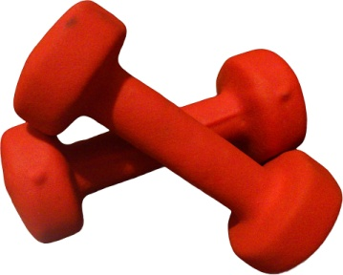
A Distribution of Hard Instances
Consider the cut function of the complete bipartite graph with edge weights 2:
(A, B) is a random partition of the vertices into two equal sets.
A
B
For every set S:
The maximum value is .

Slide 27
Deterministic Algorithms
Given the complete graph input, a deterministic algorithm makes a series of queries: Q₁, Q₂, …, Q_{m}.
For every set Q_{i}:
For the bipartite complete graph
W.h.p. |Q_{i} ∩ A| ≈ |Q_{i} ∩ B|
We assume |Q_{i} ∩ A| = |Q_{i} ∩ B| = |Q_{i}| / 2
The value of Q_{i}:
Value (complete graph)
|Q_{i}| ⋅ (n - |Q_{i}|)
Value (bipartite complete graph)
w.h.p. |Q_{i}| ⋅ (n - |Q_{i}|)
The deterministic algorithm:
w.h.p. makes the same series of queries for both inputs.
w.h.p. cannot distinguish the two inputs.
has an approximation ratio of at most ½ + o(1).

Slide 28

Sealing the Deal
Hardness for Randomized Algorithms
Our distribution is hard for every deterministic algorithm.
Hardness for randomized algorithms from Yao’s principle.
Getting Rid of the Assumption
A query set Q cannot separate the inputs when
|Q ∩ A| = |Q ∩ B|.
This should be true also when |Q ∩ A| ≈ |Q ∩ B|.
The bipartite graph input should be modified to have f(Q) = |Q|⋅ (n - |Q|) whenever |Q ∩ A| ≈ |Q ∩ B|.

Slide 29
Getting Rid of the Assumption (cont.)
The Modified Function
When –εn ≤ |S ∩ A| – |S ∩ B| ≤ εn (for an arbitrary ε > 0):
Otherwise:
The extra terms:
  keep the function submodular.
  decrease the maximum value by O(εn²).
Resulting in a hardness of ½ + ε.
✓

Slide 30
Questions
?

